Slide 1
Task 3 Summary

Slide 2
All Files Analysed
Forums data
1. bogleheads_investing_theory_forum_google_Drive @Mohamed Awnallah
2. bogleheads_personal_finance_forum_data_google_Drive (working on it) @Priya Gupta @kevin wang
3. myfico_forum_data_google_Drive
Quora
1. What are the most useful money investment and savings @Lamia Sekkai
2. What are some money saving tips @Lamia Sekkai
3. what are the best ways to save money @Minh Huong Ngo @Lamia Sekkai
4. quora questions answers @Shivaani Krishnakumar
Reddit
1. budget @mukund shah
2. finance @Neethu Prabhakaran
3. investing @deepali
4. personalfinance @Vivienne Ordonez
5. savingmoney @Garima Kapoor
Twitter
1. tweets @Raul Catacora Grundy

Slide 3
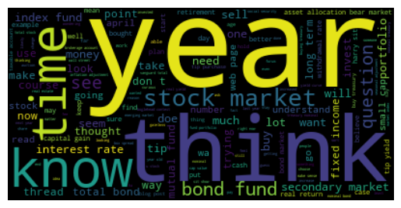
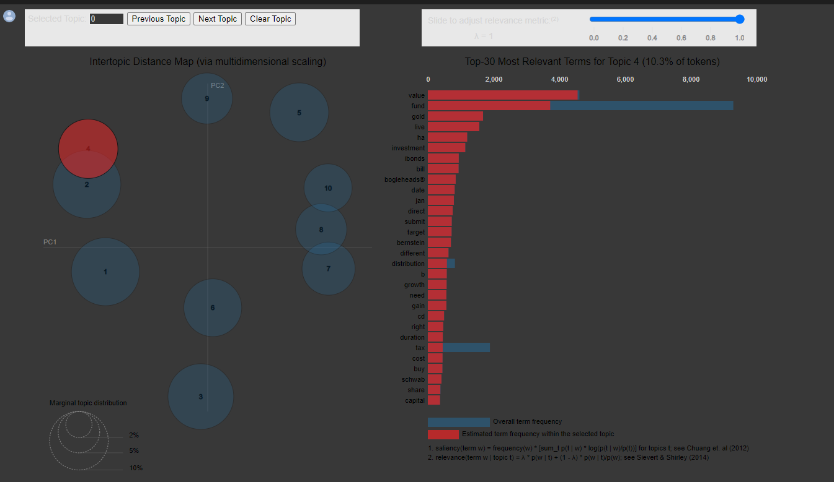
bogleheads_investing_theory
Shape of all data:(112679, 9)
3648 unique questions
3654 unique answers
Information gathered and all analysis would help next tasks

Slide 4
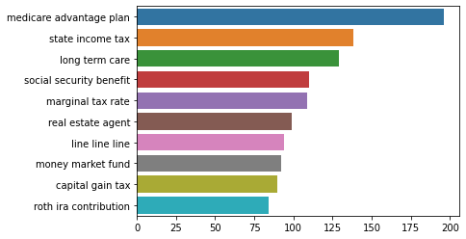
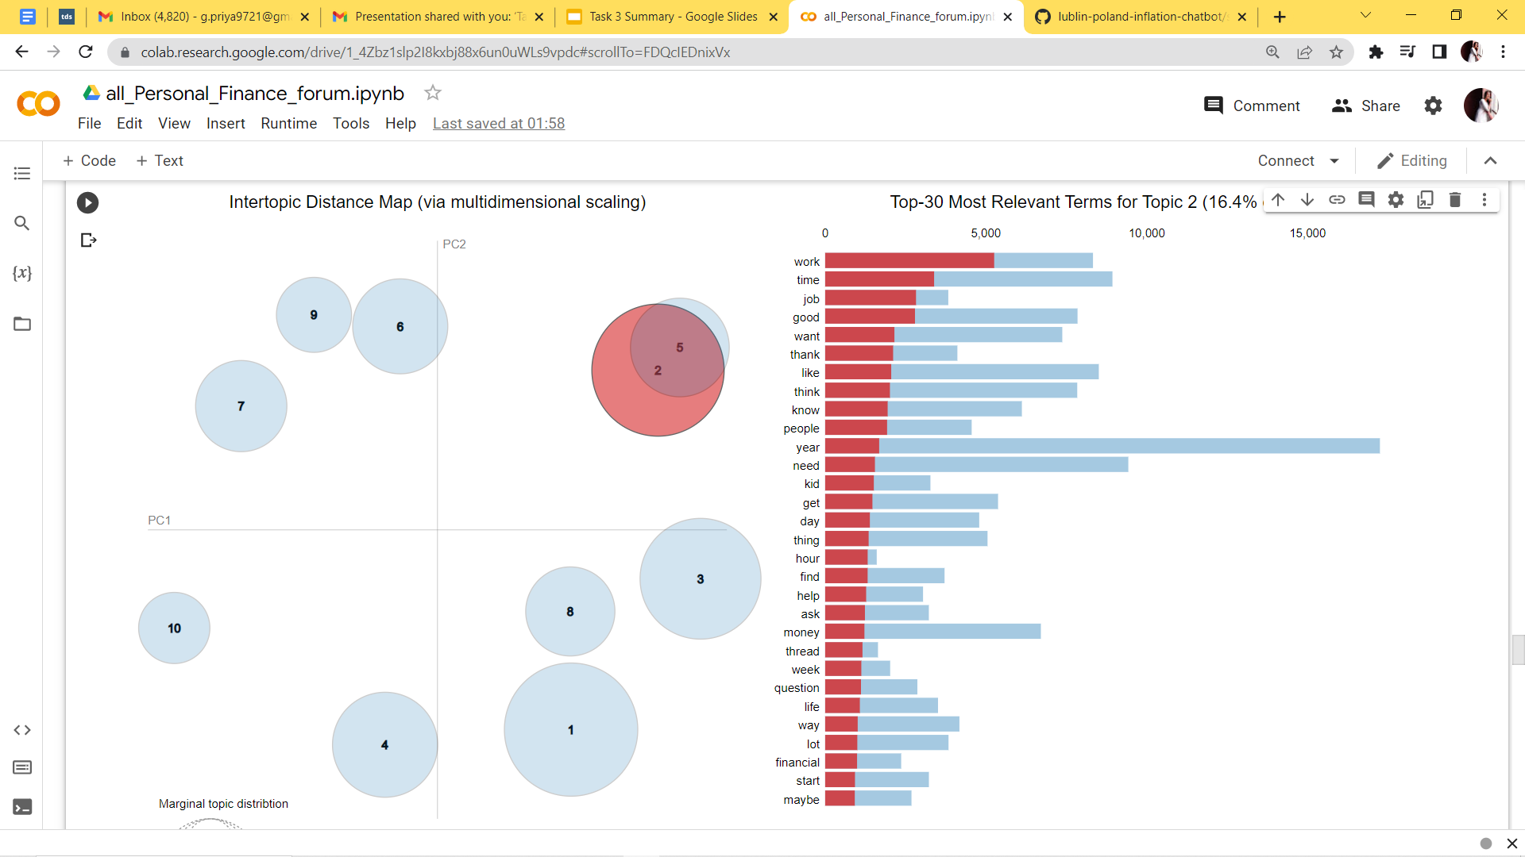
bogleheads_personal_finance_forum_data
Shape- (138792,9)
Conclusions:-
Most of the post titles includes credit card, social security, net worth, interest rate, Roth conversion et. are some of the major concerns of people when it comes to personal finance.
When it comes to forum and personal finance questions, people are mostly concerned with Roth IRA which is an Individual Retirement Account, followed by social security, years old etc.
When it comes to replies, many repliers has talked about Medicare advantage plan, state income tax ,long term care and social security benefits.
For both post and reply text, the Flesch Reading Ease complexity lies majorly between 0 to 100 that means it can easily be understood by an average 11 year old student.

Slide 5

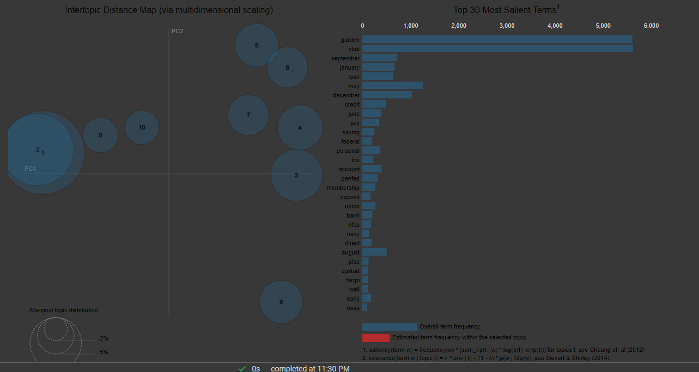
myfico_forum_data
Shape of all data: (12461, 11)
5587 unique questions
5587 unique answers
Information gathered and all analysis would help next tasks
There’s a pre processing to follow within the dataset because there are some repeated words and post about what seems to be ads or a kind of service.

Slide 6
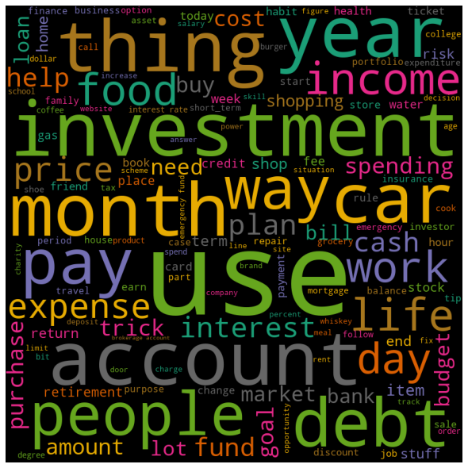
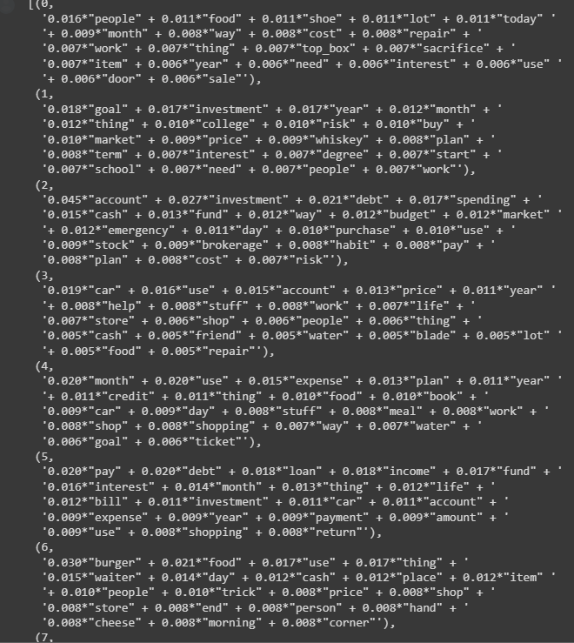
Quora - What are the most useful money investment and savings
From the data, there exists seven topic around the questions.
Might need more preprocessing to be useful for the chatbot.

Slide 7
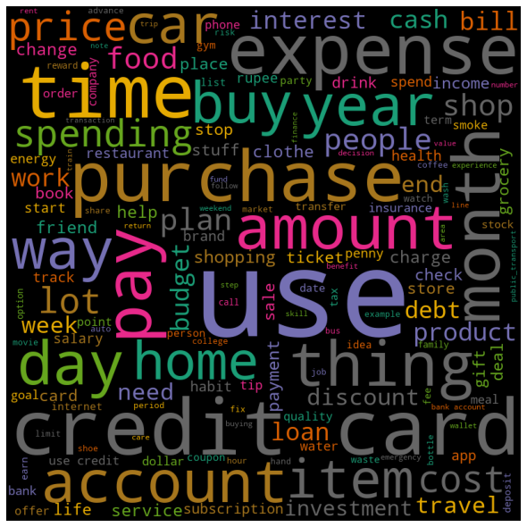
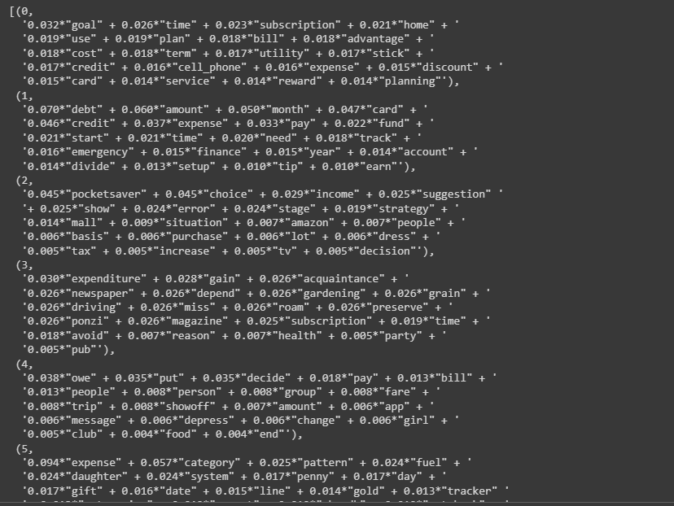
Quora - What are some money saving tips
There is 12 topics around the information extracted from the data.
Might need more preprocessing to be useful for the chatbot.

Slide 8
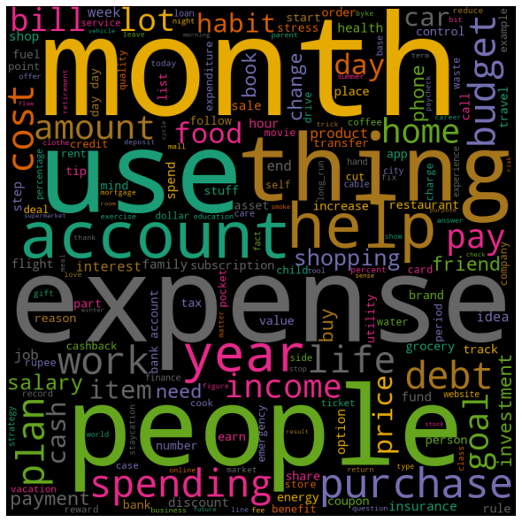
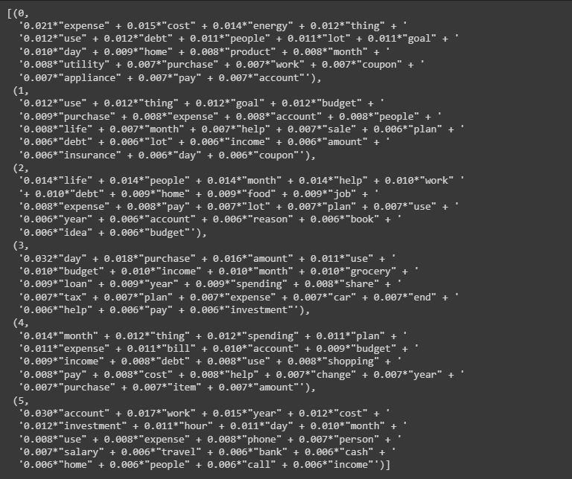
Quora - what are the best ways to save money
There is 5 topics around the information extracted from the data.
Might need more preprocessing to be useful for the chatbot.

Slide 9
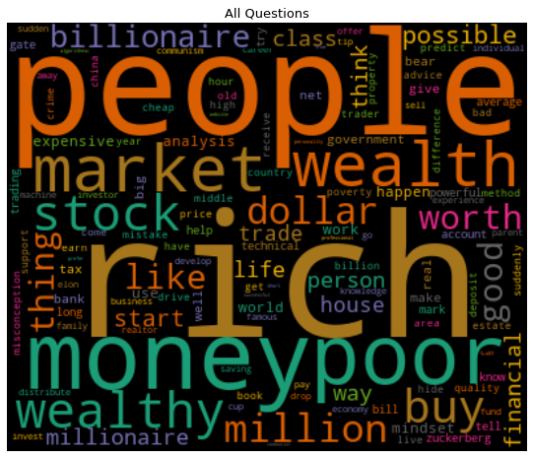
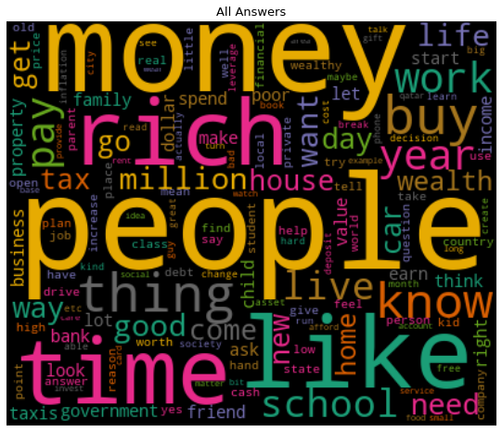
Quora - quora questions answers
The shape of the data is: (222, 10)
As the data columns are already into a question/answer. Definitely can be used into the development of the chatbot, with proper preprocessing

Slide 10
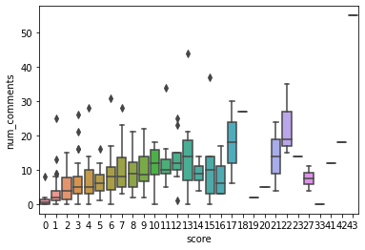
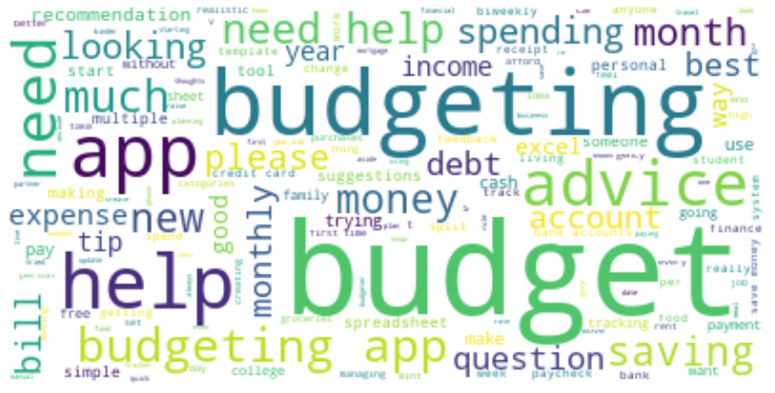
Reddit - budget
The shape of the data: (446, 8)
Could be processed to get the most value from the data.
There is like a good Quantity of Questions.
No really for the answers.

Slide 11
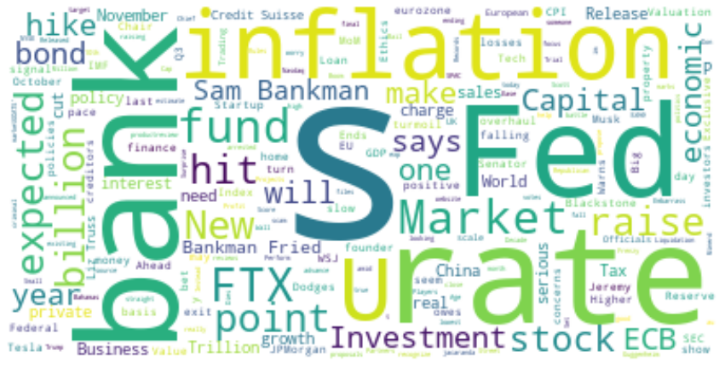
Reddit - finance
The shape of the data: (100, 10)
Could be processed to get the most value from the data. There are interesting questions but there are no specific answers.
There’s a interesting analysis about polarity and subjectivity. To assess the value of the information.

Slide 12
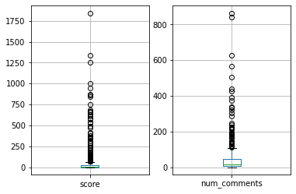
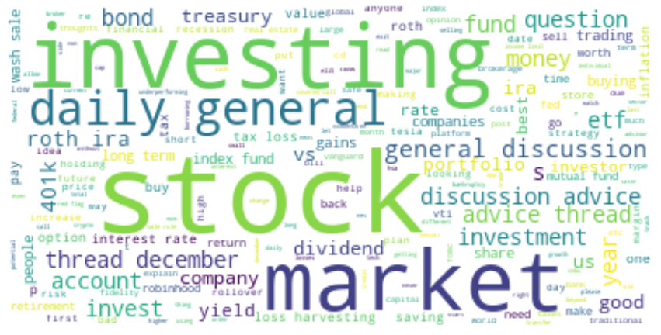
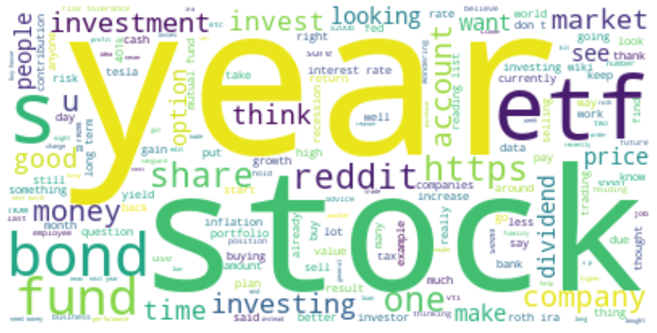
Reddit - investing
Above boxplots for feature 'score' and 'num_comments' indicate a high number of outliers in the column, but because the score is relevant to the quantity of comments and the calibre of the Reddit account, outlier treatment can result in the loss of crucial information.
The shape of the data: (415, 8)
There is no a question/answer format to assess if it is possible to use the data for the development of the chatbot.

Slide 13
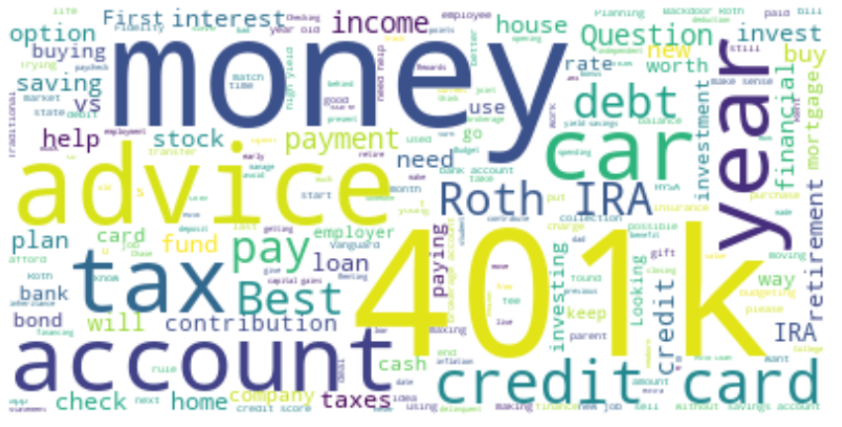
Reddit - personalfinance
Most frequent words consisted of US-specific financial concerns, such as 401k, ROTH.
The scores are quite useful on their own, however if the data exists within your file, please make sure to compare upvotes vs. downvotes (scores are computed as upvotes - downvotes). In my case, I didn't have data on these so I cannot conclude if the posts weren't heavily interacted with or if there are downvotes that cancelled out any upvotes.
For comments, most of them fell within low values but by looking at the top commented posts (even if these are only a few) we may be able to see what the most interacted subject matter is.
As it seems that the information goes around a very particular topic, this means it won’t be really help full for the development. Maybe a good idea would be to like scrape data over or make another type of analysis

Slide 14
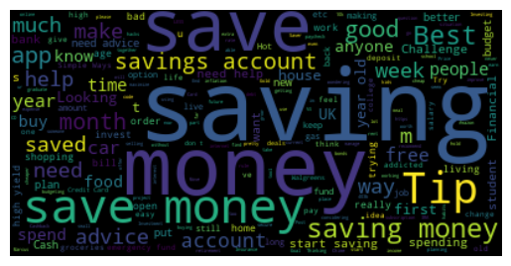
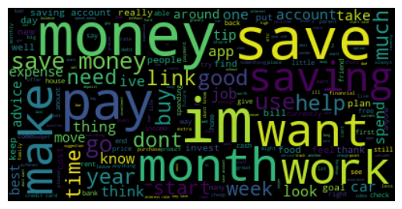
Reddit - savingmoney
The shape of the data: (500, 8)
There’s still the discussion about if it is possible to use this data as there’ a bunch of questions but no really their answers.
Preprocessing needed to suit the main goal.

Slide 15
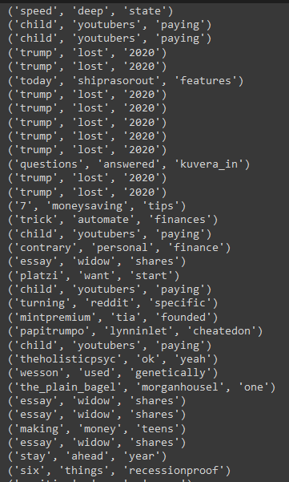
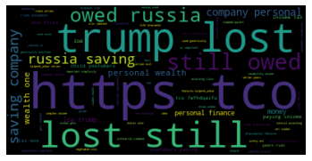
Twitter - tweets
Just 100 records from the data with 3 columns
About a year of information gathered
Must of information are opinions and there’s not really Question and Answers.

Slide 16
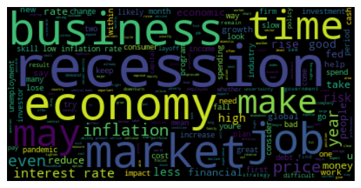
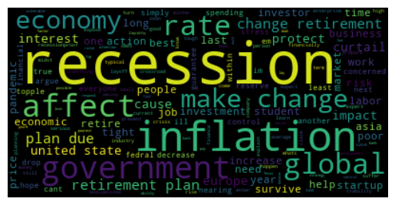
Bonus Dataset QA
Really useful insight and very nice analysis and understanding of the main goal.
Dataset could be used as knowledge based for the chatbot.
57 question and answers

Slide 17
Thank you all for your contribution.
Open for discussion.

